Slide 1
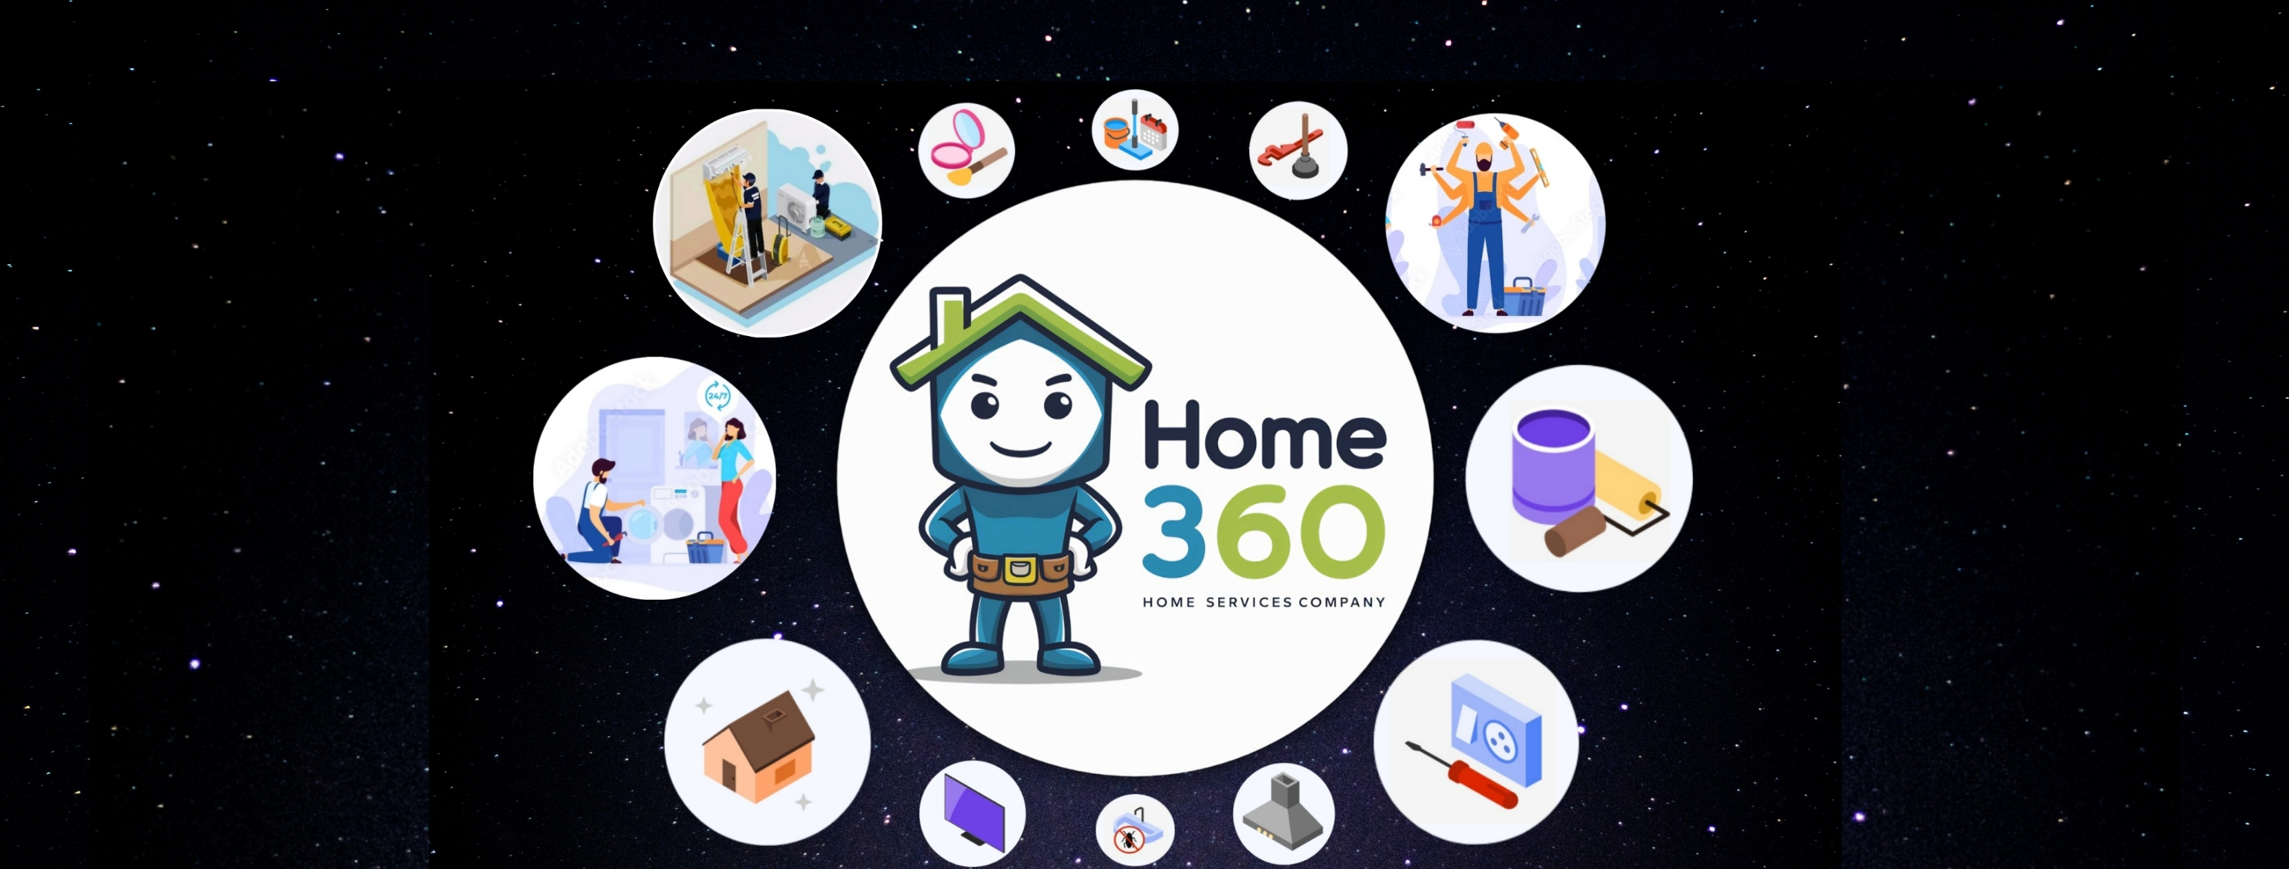
HOME360
-Home Services Company

Slide 2

Priyanka Dosapati
Email: dosapatip2@udayton.edu
Team leader for the project “Home360”
Technical skills: Python, Django, MySQL, Java Script, HTML & CSS

Slide 3

Rohit Kumar Manne
Team Member:1
Email: manner1@udayton.edu
Technical skills:Python, Guidewire, Express.js, Django,Angular,JavaScript, HTML & CSS, SQL

Slide 4

Tushar Rohilla
Team Member: 2
Email: rohillat1@udayton.edu
Technical skills: HTML, CSS, JAVASCRIPT, JQuery, Python, SQL Server, React, Node Js

Slide 5
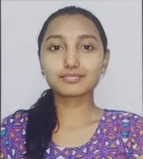
Venkata Sai Pranavi Marripudi
Team Member: 3
Email: marripudiv1@udayton.edu
Technical skills: Java, Angular, Python, Spring Boot, Java Script, HTML & CSS

Slide 6

Project Statement
Home360 is an application designed to connect homeowners with reliable, local service providers for various home maintenance and repair needs. Home360 aims to simplify the process of finding, booking, and managing home services, offering a seamless and user-friendly experience.

Slide 7
Functions of HOME360
01
02
03
04
05
07
User Registration and Profile Management
Service Listing and Search
Booking and Scheduling
06
Customer Reviews and Ratings
Secure Payments
Service Provider Management
User Feedback and Improvement

Slide 8
01
Team Leader - Use Case Realizations
Usecases worked on:
Search for Worker
Schedule Worker
Request service fee from customer
Send service request details to worker
Send account statement to worker
Record workers attendance
Request complete payment from customer
Monitor the work status
Usecase: Search for worker

Slide 9
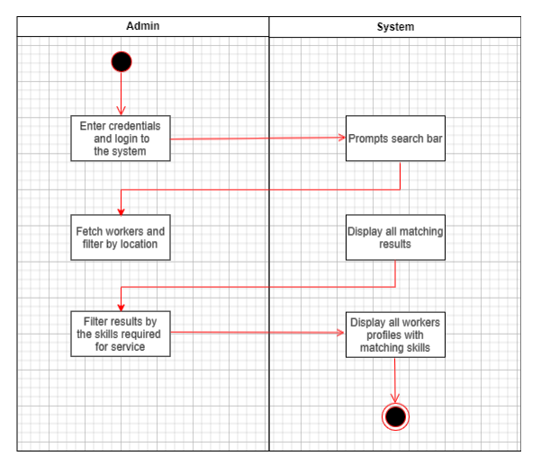
Activity Diagram:

Slide 10
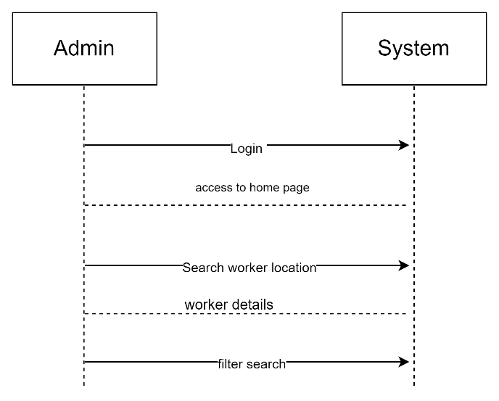
Sequence Diagram:

Slide 11
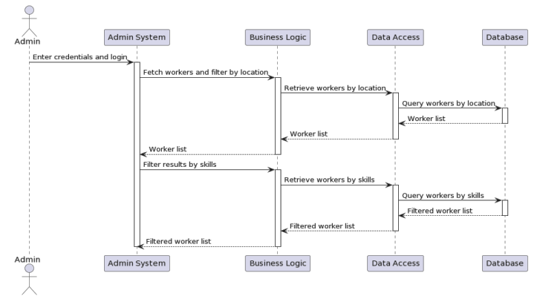
System Sequence Diagram:

Slide 12
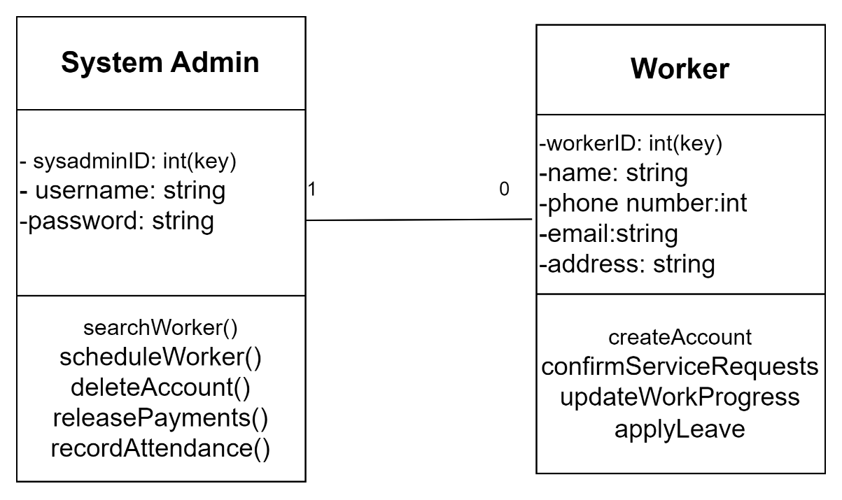
Design Class Diagram:

Slide 13
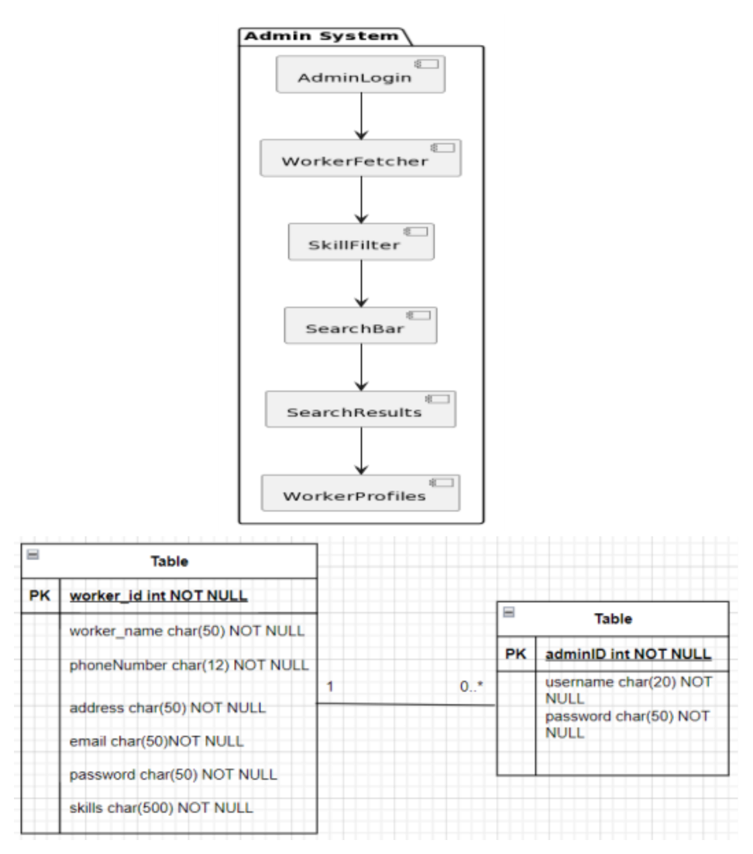
Component Diagram:

Slide 14
01
Team Leader
No. of pages: 39
Modules Worked on:
User Profile : LOC-201
Service Category: LOC -199
Service: LOC -228
Service Provider: LOC -221
Service Provider profile: LOC -176
Service Review: LOC -138
Booking: LOC - 216
Payment: LOC - 201
Comments: Faced issues during initial setup

Slide 15
02
Team Member 1- Use Case Realizations
Usecases worked on:
Release the payment for worker
Refund customer
Management Service Reviews
Delete Account
Request service list from customer
Create customer account
Submit service request
Cancel service request
Use Case:Monitor the work status

Slide 16
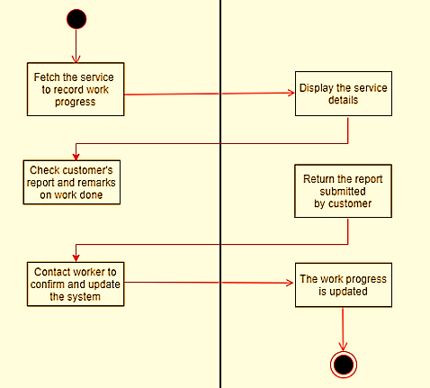
02
Activity Diagram

Slide 17
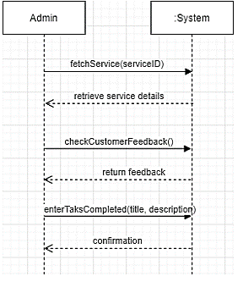
02
Sequence Diagram

Slide 18
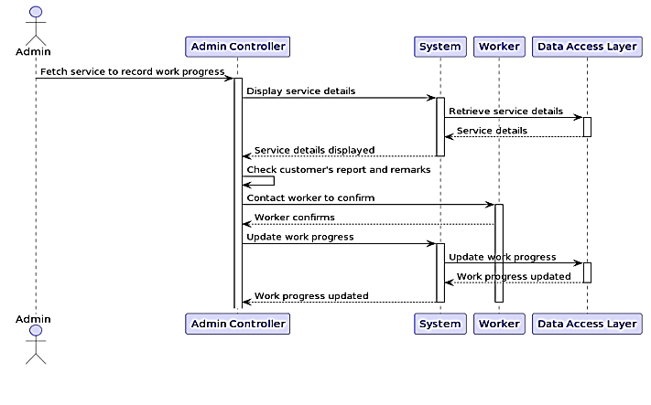
02
System Sequence Diagram

Slide 19
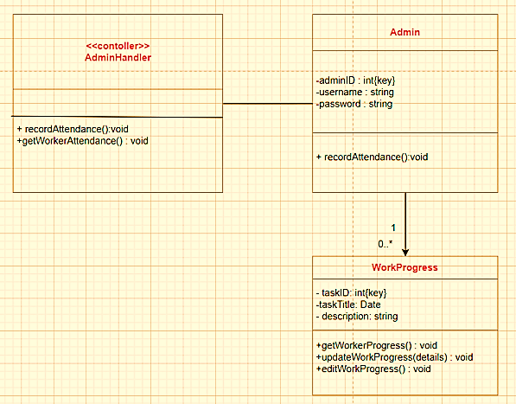
02
ER Diagram

Slide 20
02
Team Member 1
No. of pages: 26
Modules Worked on:
Notification: LOC-156
Address : LOC-163
Service Schedule : LOC-208
Service Request : LOC-211
Invoice : LOC-180
Service Category Translation : LOC-83
FAQ : LOC-77
Promotion : LOC-161
Comments: faced issues during development

Slide 21
03
Team Member 2 - Use Case Realizations
Usecases worked on:
Request reschedule the service
Service Fee payment
Make full payment for service
Provide feedback for worker
Booking multiple services
Update customer profile
Manage customer privacy
Use case:Request reschedule the service

Slide 22
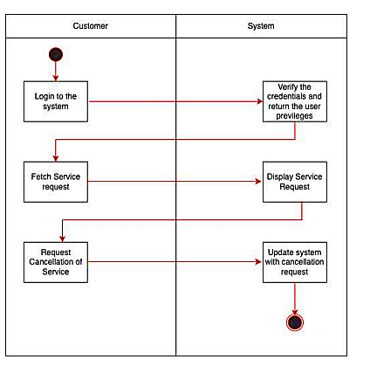
03
Activity Diagram

Slide 23
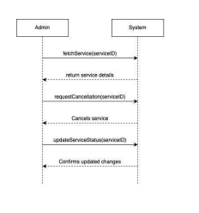
03
Sequence Diagram

Slide 24
03
Team Member 2
No. of pages: 20
Modules Worked on:
Service History: LOC- 189
Complaint : LOC- 132
FAQ category : LOC- 164
System Admin : LOC-161
Service Provider Document : LOC- 146
Subscription : LOC- 160
Service Provider Rating : LOC- 145
Comments: Faced issues during integration of modules

Slide 25
Team Member 3 - Use Case Realizations
Usecases worked on:
Manage Payment methods
Create worker account
Update skills and service for worker
Updates availability
Confirm service request
Update work status to company
Respond to reviews
Usecase: Create worker account

Slide 26
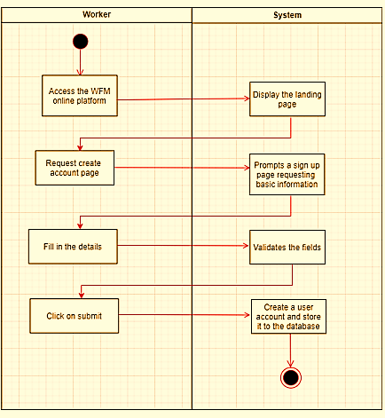
Activity Diagram:

Slide 27
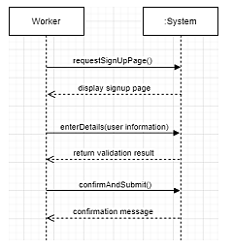
Sequence Diagram:

Slide 28
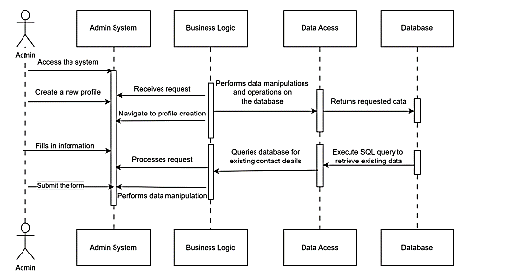
System Sequence Diagram:

Slide 29
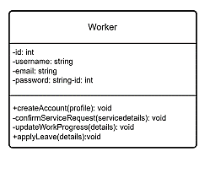
Design Class diagram:

Slide 30
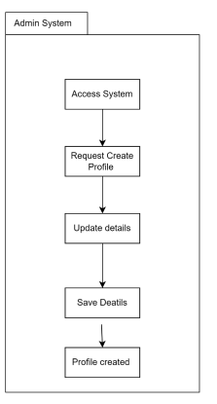
Component Diagram:

Slide 31
Team Member 3
No. of pages: 28
Modules Worked on:
FAQ Translation: LOC-189
Payment Method: LOC-132
Booking History: LOC-164
Service Discount: LOC-161
Provider Feedback: LOC-146
Customer Support Ticket: LOC-160
System Log: LOC-120
Comments: faced issue during payment gateway

Slide 32
Ethical Dilemma
We have used some of the diagrams from the previous work of WorkForceManagementService and Darshana Gowda. We have used 2 Activity diagrams in customer use cases, 3 sequence diagrams in worker use cases and 2 ER in admin use cases.

Slide 33
Effort
Team Member/Hours by phase | No. of hours by member Phase I | No. of hours by member Phase II | Total Hours
Leader | 40 | 29 | 69
Member1 | 36 | 30 | 66
Member2 | 30 | 26 | 56
Member3 | 38 | 28 | 66
Quality of work:
Clear and Engaging Content
Trust and Credibility
Feedback Mechanism

Slide 34
Challenges
1. User Authentication and Management Challenge: Making sure the login and user management system is secure and easy for everyone—whether it’s customers, service providers, or admins.
Solution: Django’s built-in tools can help here, and you might want to add extra features like social logins or two-step verification for added security and convenience.
2. Service Booking and Scheduling Challenge: Building a smooth and reliable system for booking services—like making sure appointments don’t overlap and everyone gets timely reminders.
Solution: Use Django’s database tools to handle bookings and look into calendar libraries to manage scheduling effectively.
Payment Integration Challenge: Ensuring payments are processed safely and efficiently.
Solution: Connect with trusted payment processors like Stripe or PayPal. They offer Django-friendly integration options to keep transactions secure.

Slide 35
Lessons Learned
Clear Vision and Goals: Establishing a clear vision and set of goals from the beginning helped keep the project focused and aligned.
Requirement Gathering: Frequent revisions and validations of requirements helped avoid scope creep and ensured the project stayed on track.
Coordination between the team:
Having regular updates: Consistent communication through weekly meetings kept everyone aligned and aware of their responsibilities.
Adapting the changes: Being open to changes and flexible in approach helped the team navigate unforeseen challenges.

